Slide 1
Using EdTech to boost literacy & numeracy outcomes in South Africa: The case of Click Learning
Dr Maxine Schaefer
Aug 2024

Slide 3
On SA’s current trajectory,
it will take 86 years until all 10-yr olds can read for meaning in SA
(Spaull, 2023, p. 8).

Slide 4
Large gaps in achievement in the same grade.
Before the pandemic:
3.5 grade levels
After the pandemic:
~4 grade levels
Gr 4, PRILS (Böhmer & Wills, 2023)

Slide 5
Learners need personalised & differentiated instruction to catch up.
Content is delivered at the level of the learner (not their expected age or grade level), and at their pace.
EdTech is our solution.
Individualisation & personalisation - pace & level of the learner
Games & rewards boost motivation
More opportunities for practice
High quality and engaging content

Slide 6
Hardware is only the first hurdle...
Hardware: available, secure, cost-effective, maintained & up to date
Connectivity: reliable & affordable, electricity
Content: quality & breadth of content in the software that meets the learning goals, language needs
Capacity: learners & teachers need the skills & knowledge to work on the software & hardware
(The World Bank, 2023)

Slide 7
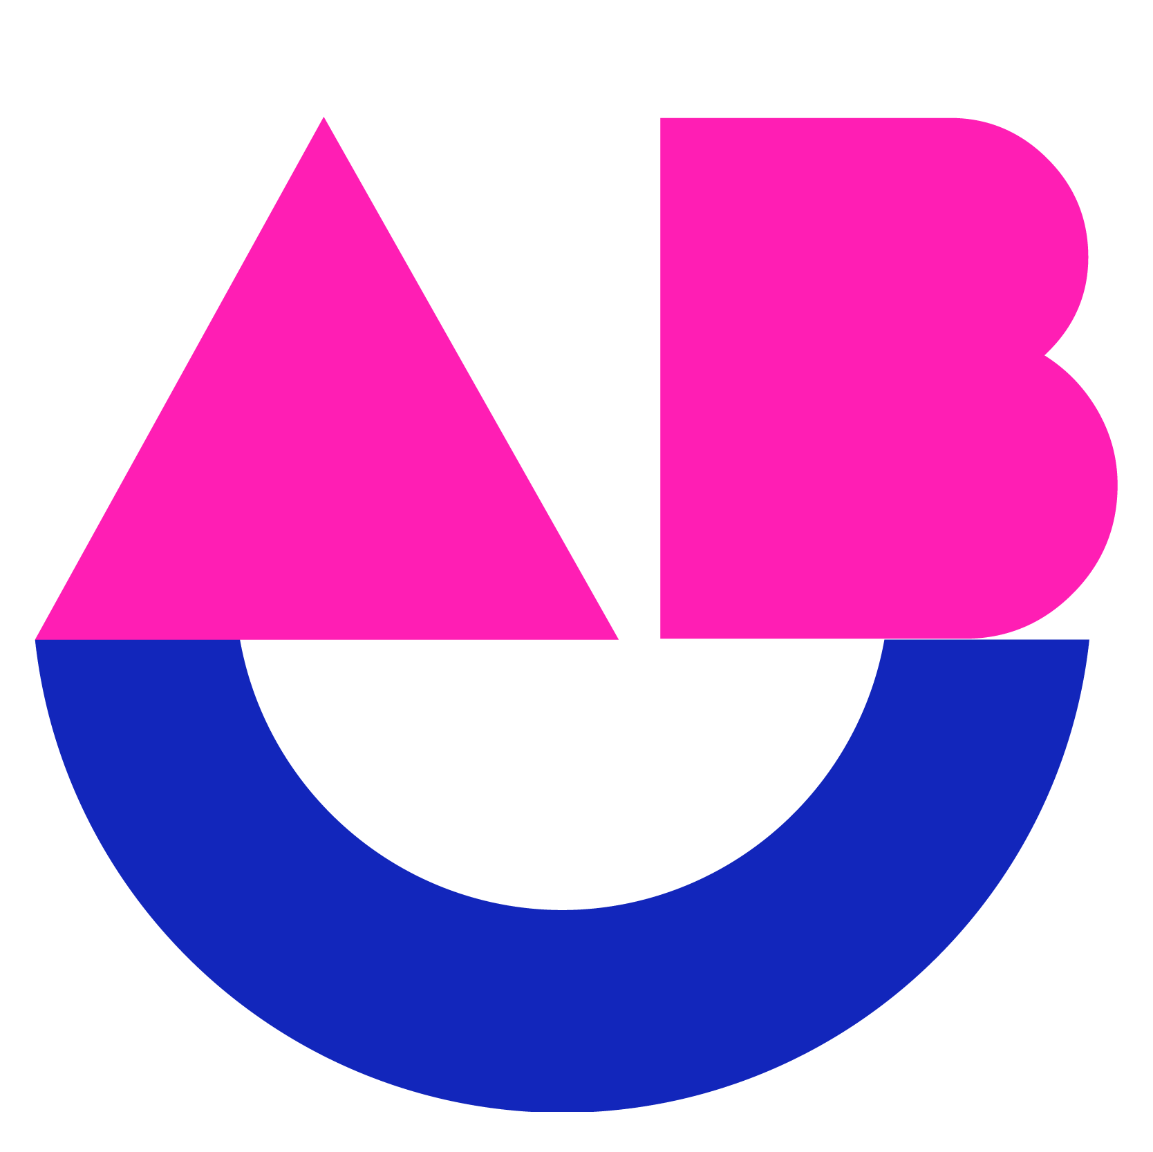
Click Learning: Who we are.
Click Learning's mission is to equip learners with the foundational literacy, numeracy, and digital skills necessary to build sustainable livelihoods in the future. Employing a holistic approach, Click Learning offers underserved schools access to:
Top-notch digital learning programs
Essential human resources
(including lab facilitators)
Vital infrastructure (such as hardware, connectivity, and backup power)
By facilitating the integration of edtech in low-resourced schools,
Click Learning is paving the way for thousands of children to succeed in school and beyond.

Slide 8
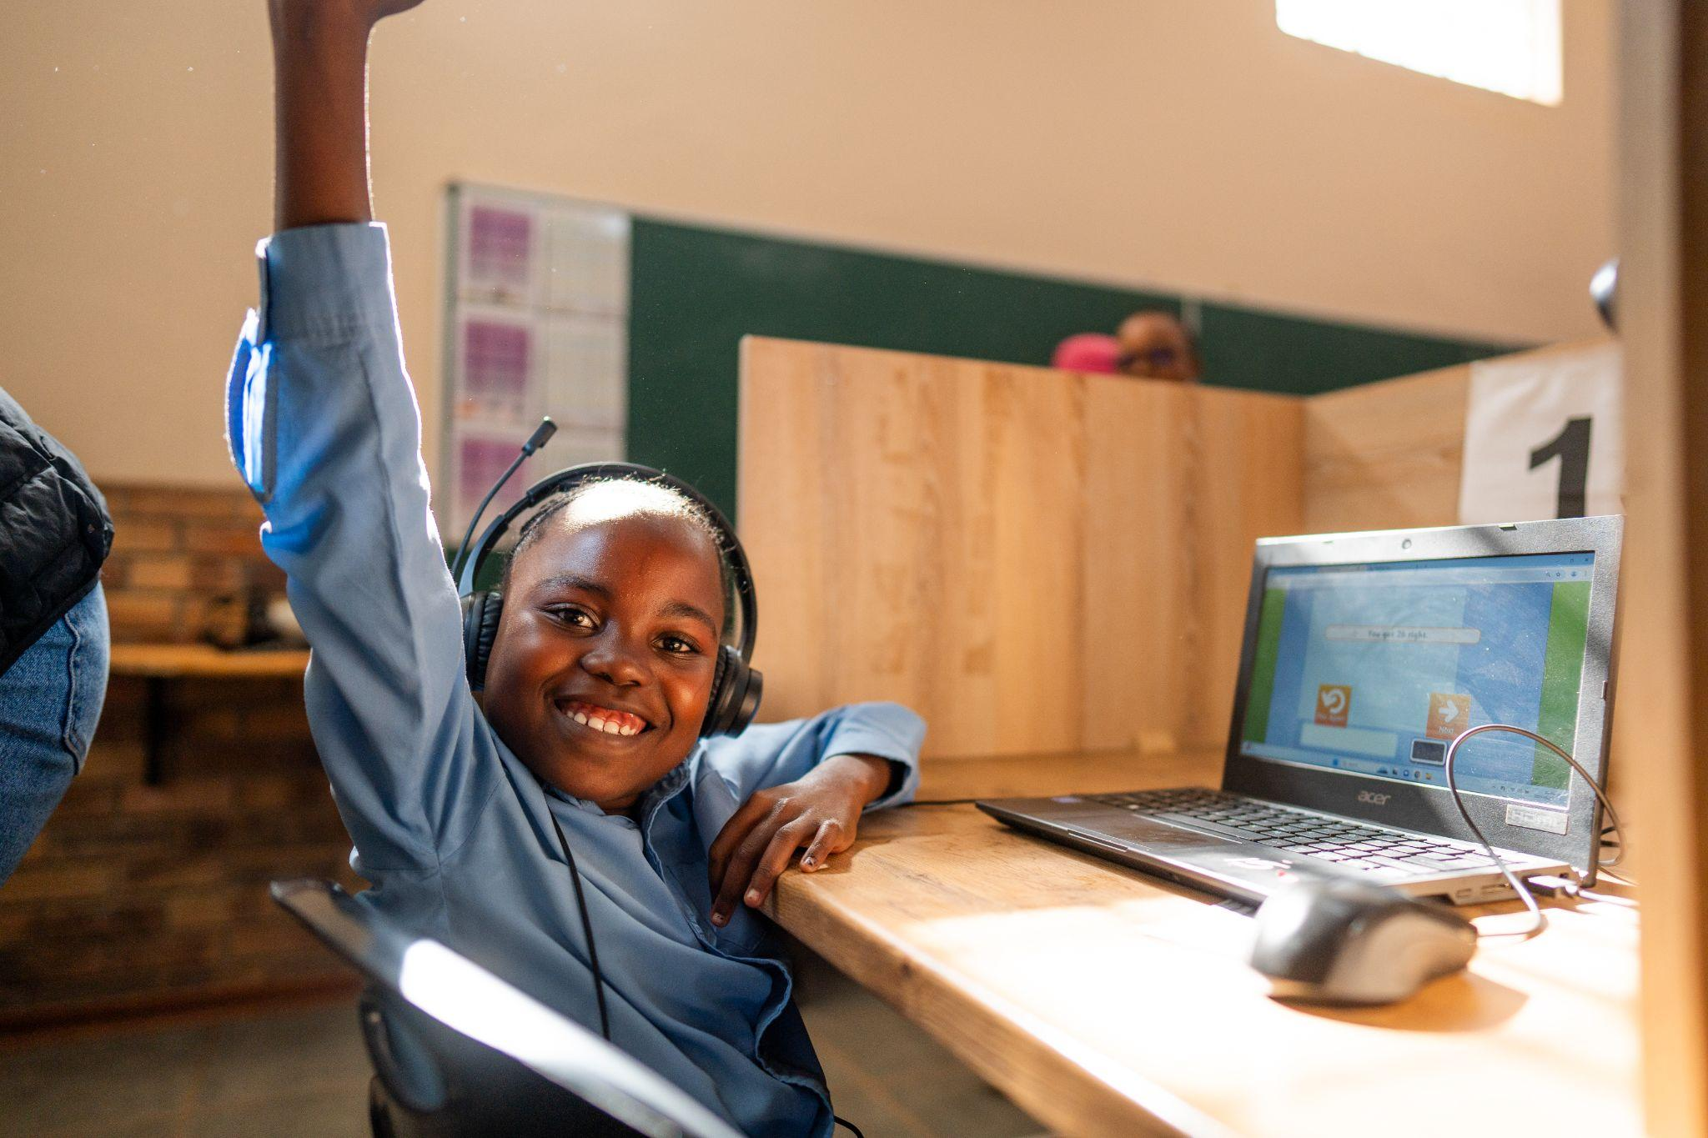
Working together to change little lives for big impact.
Click Learning computer labs. Literacy & numeracy products.
Facilitators.
School learning.
Classroom instruction. School leadership. Nutrition.
Government policy & support.
District & provincial initiatives.
DBE initiatives.
Home learning.
Parents, caregivers, community.

Slide 9
What we’re doing.
4
239,045
20,900
331
877
48,296

Slide 10
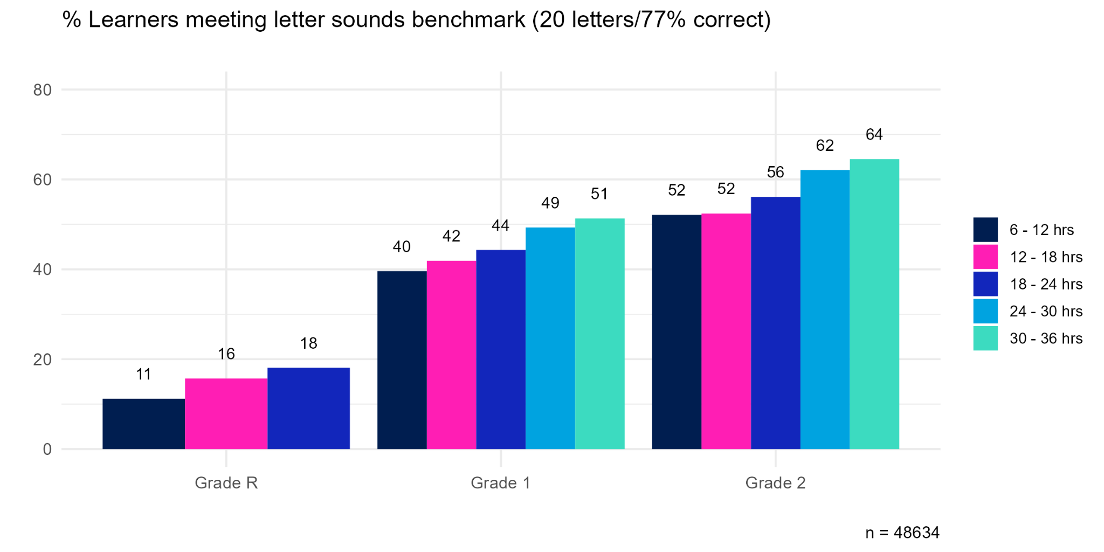
Alphabetic Knowledge.
Strong positive relation between alphabetic knowledge & word reading emerges around 77% (20 letter sounds) accuracy
For all grades tested, the % of learners meeting this threshold increases with time on the app
Testing if two hours per week will result in 80% of learners reaching the threshold after 1 year

Slide 11
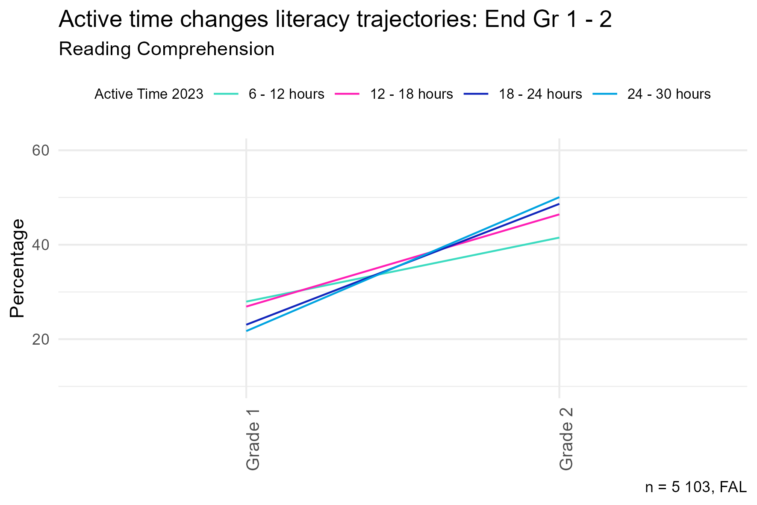
Reading Comprehension Growth.
Active time changed the rate of growth from Gr 1 - 2. Learners in EFAL schools and started in Gr 1 in 2022.
6 - 12 h: 13.6% point (48.7%) improvement
12 - 18 h: 19.5% point (72.5%) improvement
18 - 24 h: 25.6% point (111%) improvement
24 - 30 h: 28.4% point (130%) improvement

Slide 12
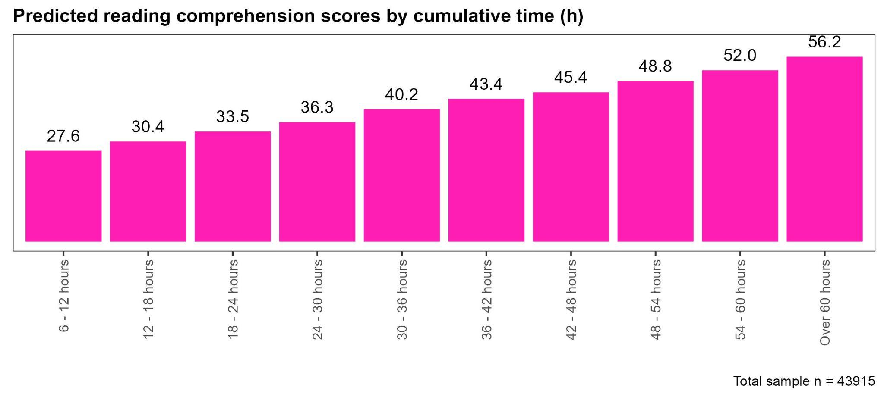
Reading Comprehension.
A grade 3 learner
In an EFAL school
Who started in grade 1 (2021)
With 48 - 54 hours cumulative time (16 - 18 hours per annum)
Scores 24.0% points more on reading comprehension than a similar learner with only 6 hours cumulative time

Slide 13
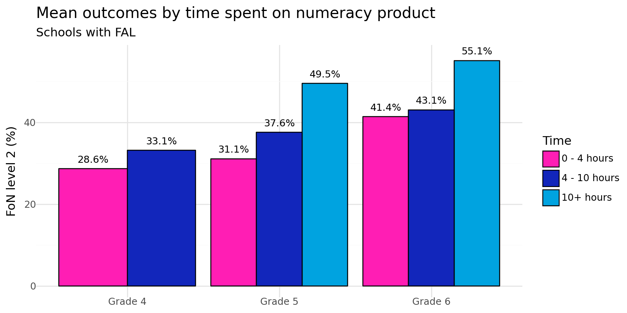
Numeracy.

Slide 14
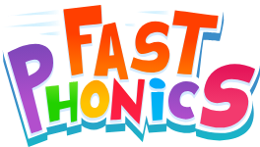
Double Click Eastern Cape
What works?
For whom?
In what circumstances?
No EdTech
“Business as usual”

Slide 15
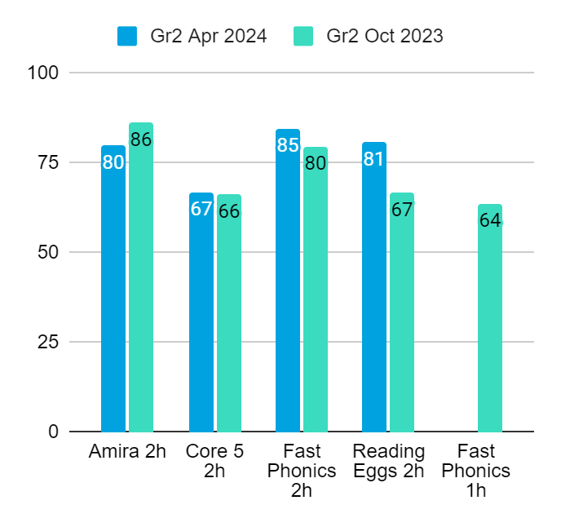
Letter knowledge benchmarks:
Gr 2s in 2024 are 6 months ahead of Gr 2s in 2023
Apr 2024
Oct 2023
Gr 2 | Term 1 | Term 2 | Term 3 | Term 4
6 months

